Slide 1
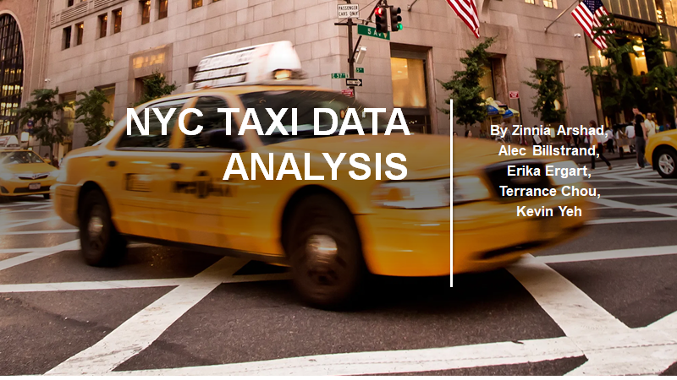

Slide 2

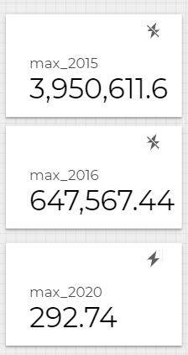
Project Summary
Problem: Due to increased competition in the public transport market, NYC yellow cab company is seeing decreased revenues since 2015. How can we help them?
ML Models:
Boosted Classifier Tree
Linear Regression

Slide 3
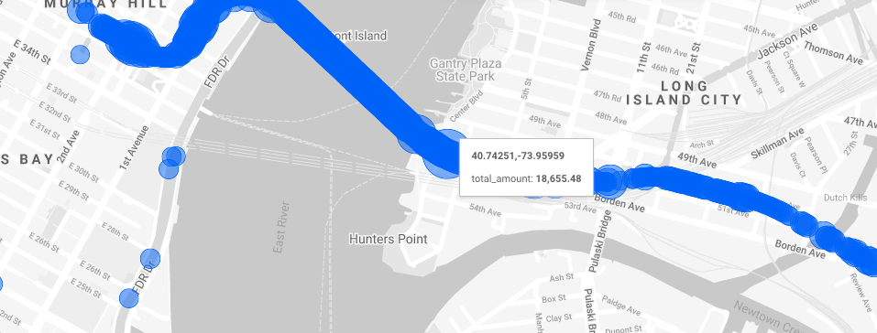
Most profitable district - EDA
Notes:
To identify the demand of the NYC cab company in our EDA we calculated the most profitable district in the city by summing up the total fare of the company in each area. Using this graph We conclude that Long island generates the most revenue due to the airport located in that area.

Slide 4
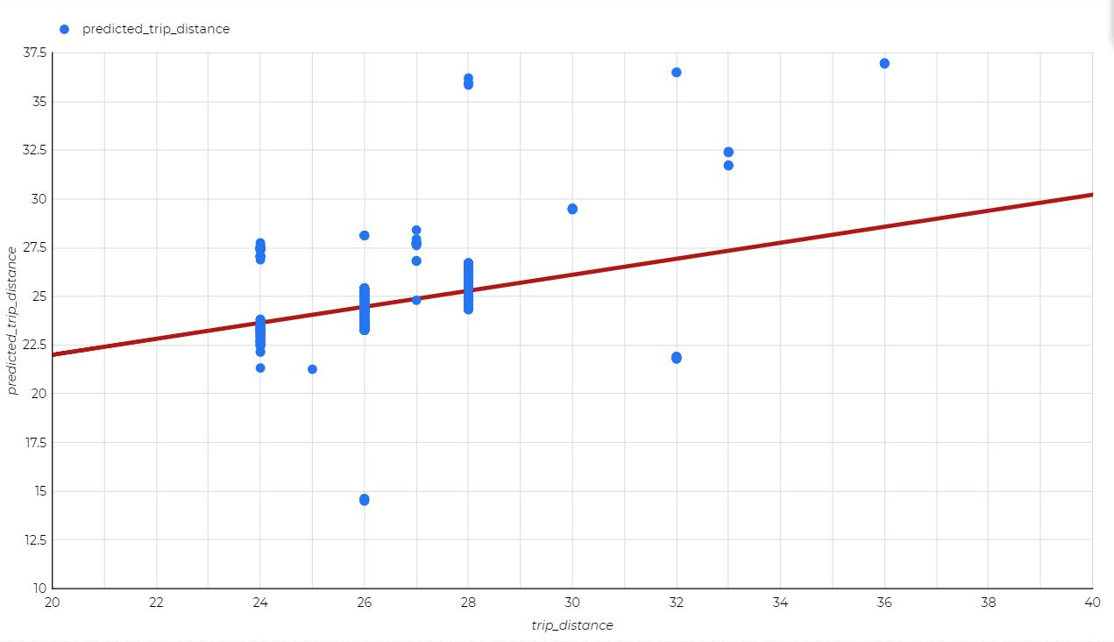
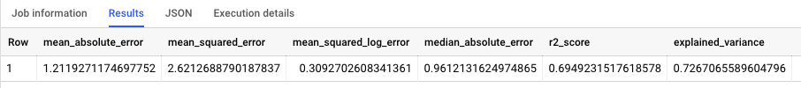
Distance prediction- Linear Regression
Notes:
We also did a linear regression for distance prediction (to include this feature in the app). This model had an R2 of 0.7 and it seems to be predicting distance quite accurately as seen from the graph above. The lower R2 of 1.07 was calculated on the test data and the second R2 of 0.69 is calculated on the streaming data hence proving that our model works better on the real time data.
This can be useful for cab drivers as they can check the predicted distance of each ride before accepting the ride so they can plan their routes better and cut down costs. data.

Slide 5
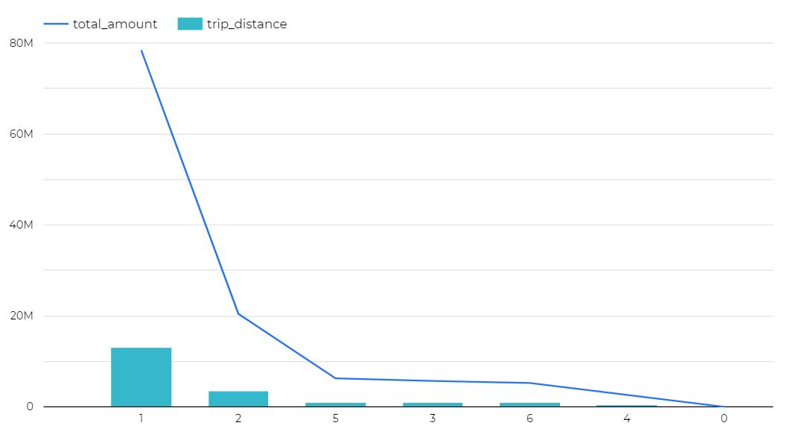
Tying the total amount and trip distance together
Notes:
From this graph we can see that As the trip distance increases the total amount decreases. moreover, Most people are using the cab for less than 1 mile.

Slide 6
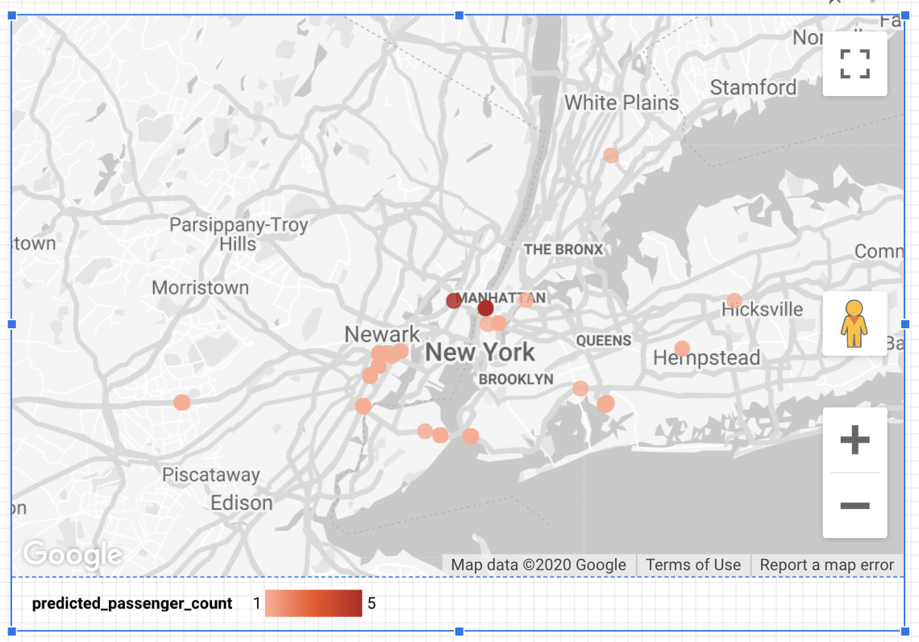
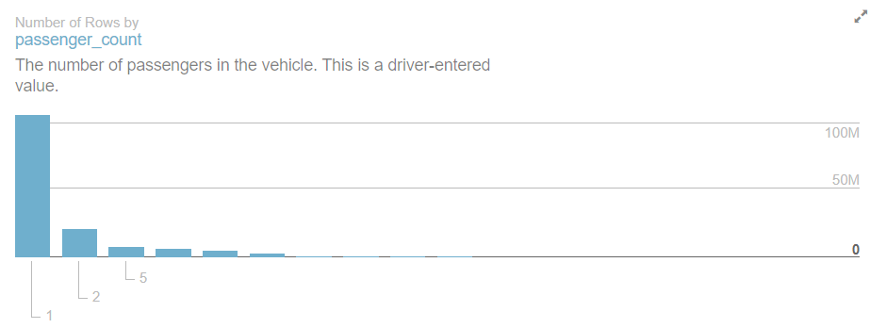
Passenger Count - Boosted Classifier Tree
100M
50M
Notes:
This graph represents the amount of passengers per car. As we can see on the right most cars are used by a single passenger however the graph on the left depicts manhattan as the epicenter of demand for bigger cars. It is evident that the average number of people per car in manhattan is 5.

Slide 7

Our Recommendations
•1. Introduce a yellow taxi App that includes more transparent fare calculation, flexible payment options (cash/credit) and calculates optimized route to lower the driving costs
•2. Have more spacious cars inside of Manhattan due to tourism
•3. Most revenue is being generated by Long Island hence introduce more cabs in this area

Slide 8
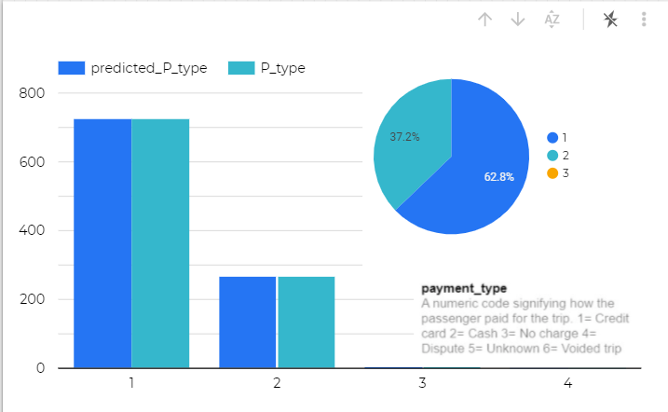
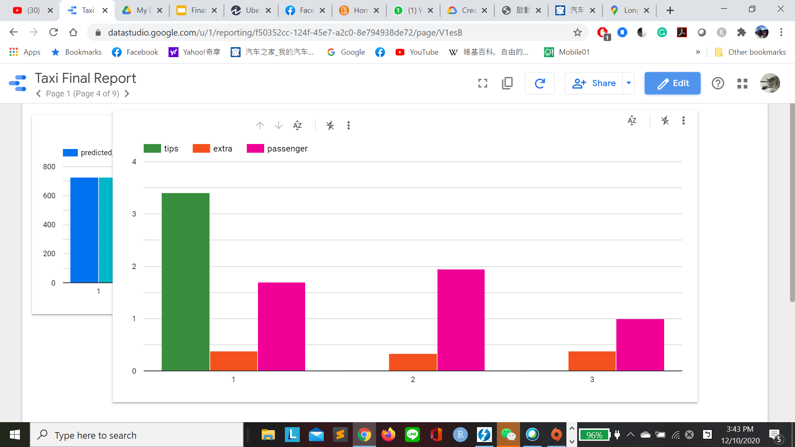
Payment Type Insights - Boosted Classifier Tree
Identical results upon predicted and real data
Majority of tips are recorded in the credit card transactions
Whereas for an extra charge, travel distances, and numbers of passengers, no clear distinction between the two payment types.

Slide 9
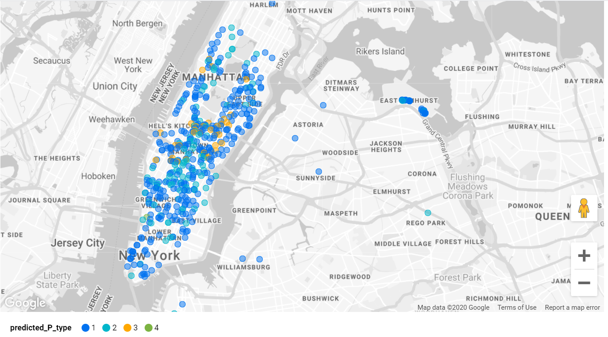
Payment Type Insights - Boosted Classifier Tree
Cash
Credit Card
No Charge
Dispute

Slide 10
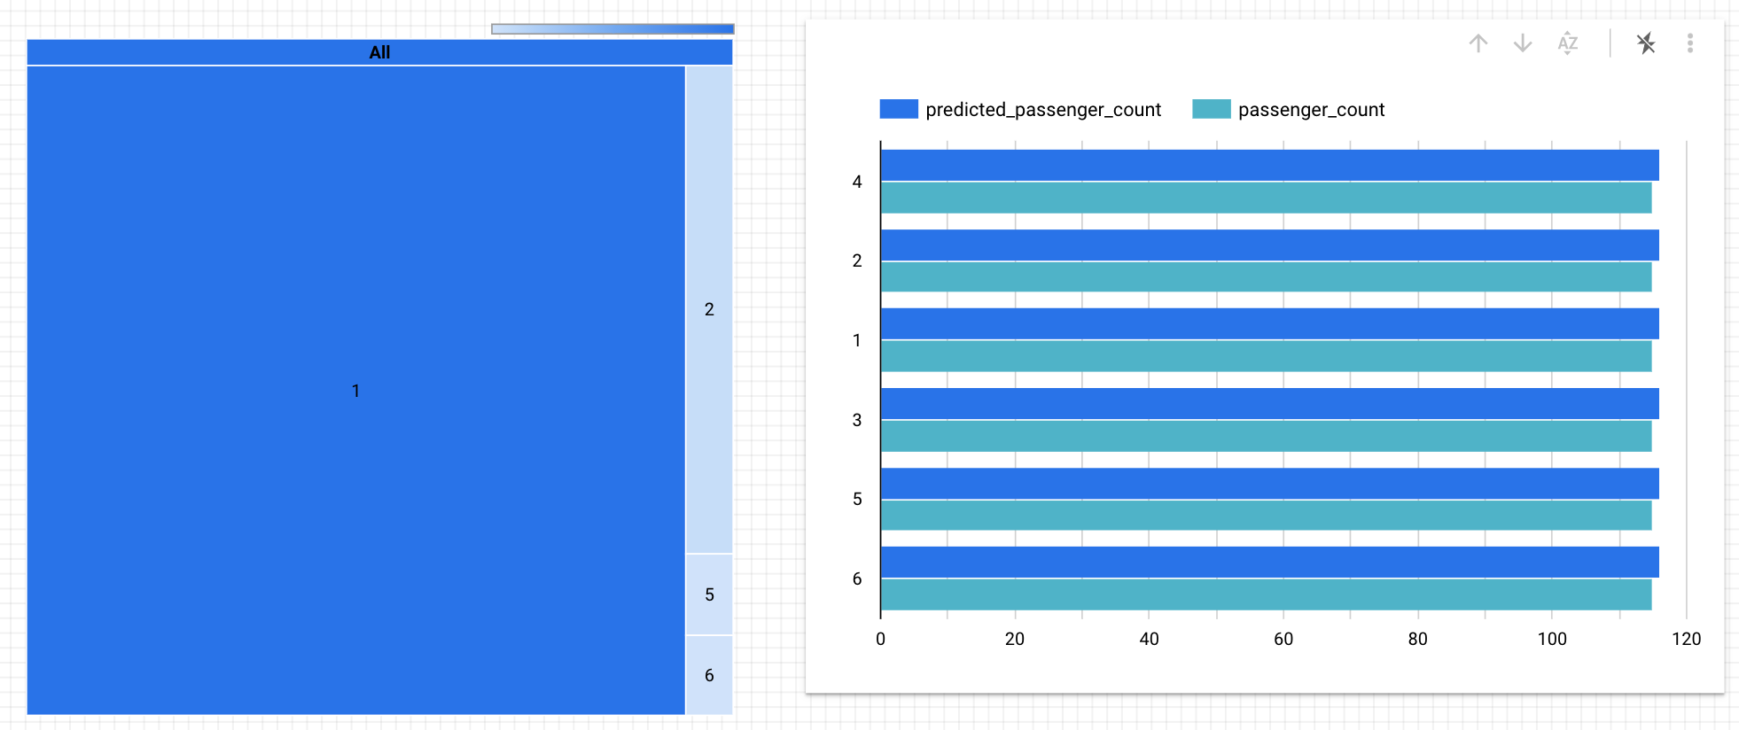
Passenger Count - Boosted Classifier Tree

Slide 11
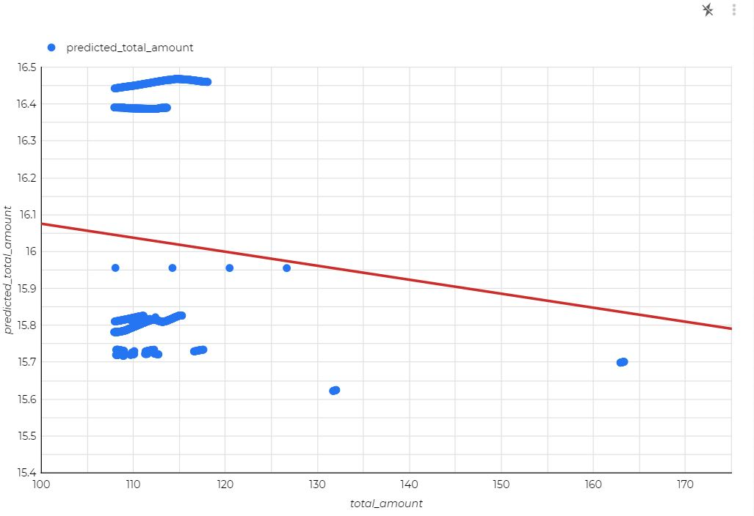
Payment Total - Linear Regression

Slide 12

Thank you!

Slide 13

Appendix

Slide 14
Note on the data
For supervised learning algorithms, it is a common practice to split the data into training and test sets to see how well a model will perform
For the purpose of this study, we are using 3 datasets:
Bigquery-public-data:new_york_taxi_trips.tlc_yellow_trips_2015 (publicly available)
Bigquery-public-data:new_york_taxi_trips.tlc_yellow_trips_2016 (publicly available)
Cloudproject-296118:taxirides.realtime_touse (from pub/sub topic)
Tlc_yellow_trips_2015 was used as a training set
In cases when it was possible (i.e., appropriate prediction values were present in the test set), realtime_touse was used as a test set
Otherwise, tlc_yellow_trips_2016 was used as a test set instead

Slide 15
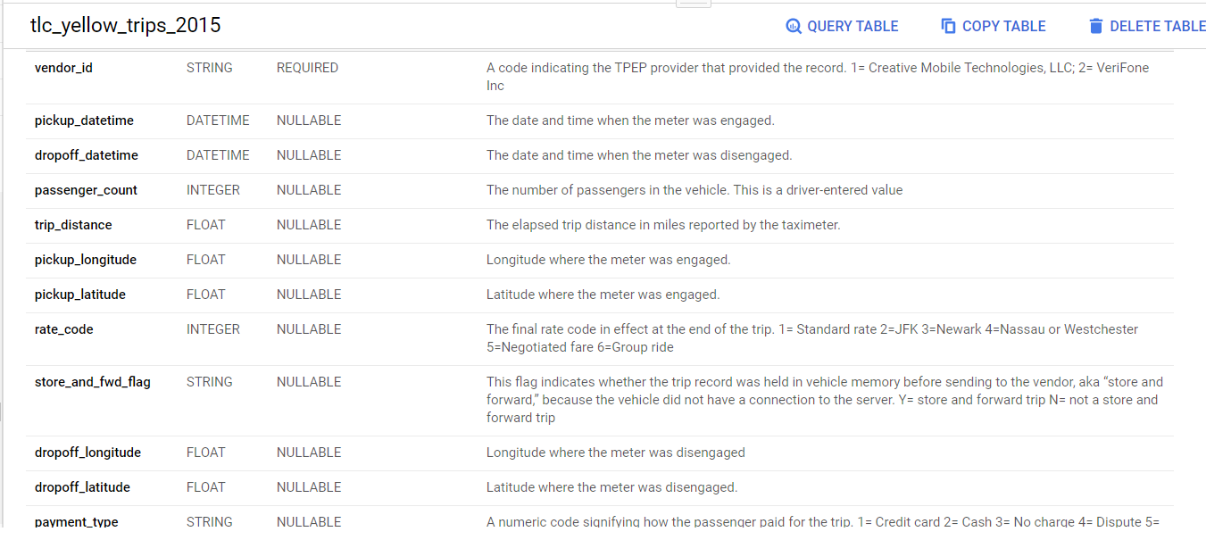
Historical Data
bigquery-public-data:new_york_taxi_trips.tlc_yellow_trips_2015

Slide 16
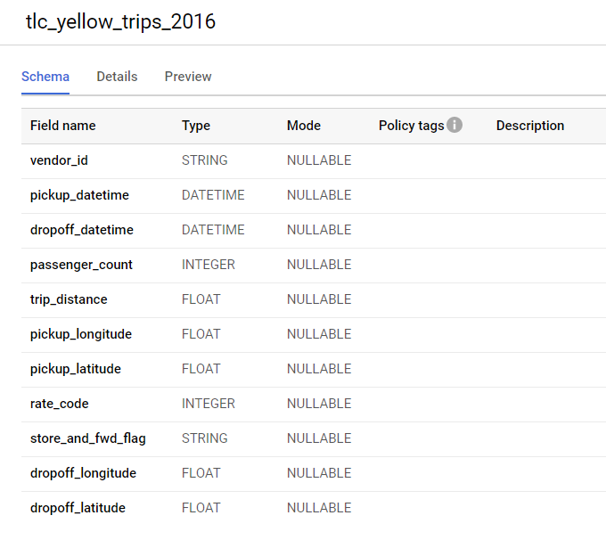
Historical Data, Continued
bigquery-public-data:new_york_taxi_trips.tlc_yellow_trips_2016

Slide 17
Streaming data
In class, we load data into the bucket, create a batch job to load data into a pub/sub topic and then creating a streaming job to transfer data from pub/sub topic to a BigQuery table
In this project, we pulled the data from a publicly available pub/sub topic (projects/pubsub-public-data/topics/taxirides-realtime) directly into BigQuery table (cloudproject-296118:taxirides.realtime)
The following code was used to create table schema for data transfer:
bq mk --time_partitioning_field timestamp --schema ride_id:string,point_idx:integer,latitude:float,longitude:float,timestamp:timestamp,meter_reading:float,meter_increment:float,ride_status:string,passenger_count:integer -t taxirides.realtime
The table is partitioned in order to not overwhelm the memory usage
Finally, the table was modified to match column names of 2015 and 2016 data sets

Slide 18
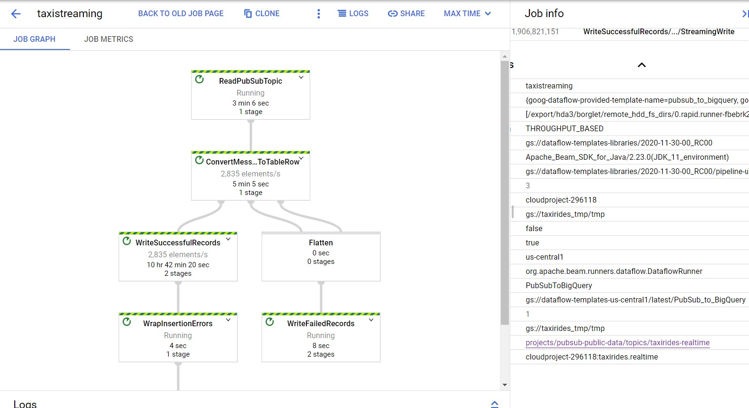
DataFlows (create, pipeline) - for current streaming data

Slide 19
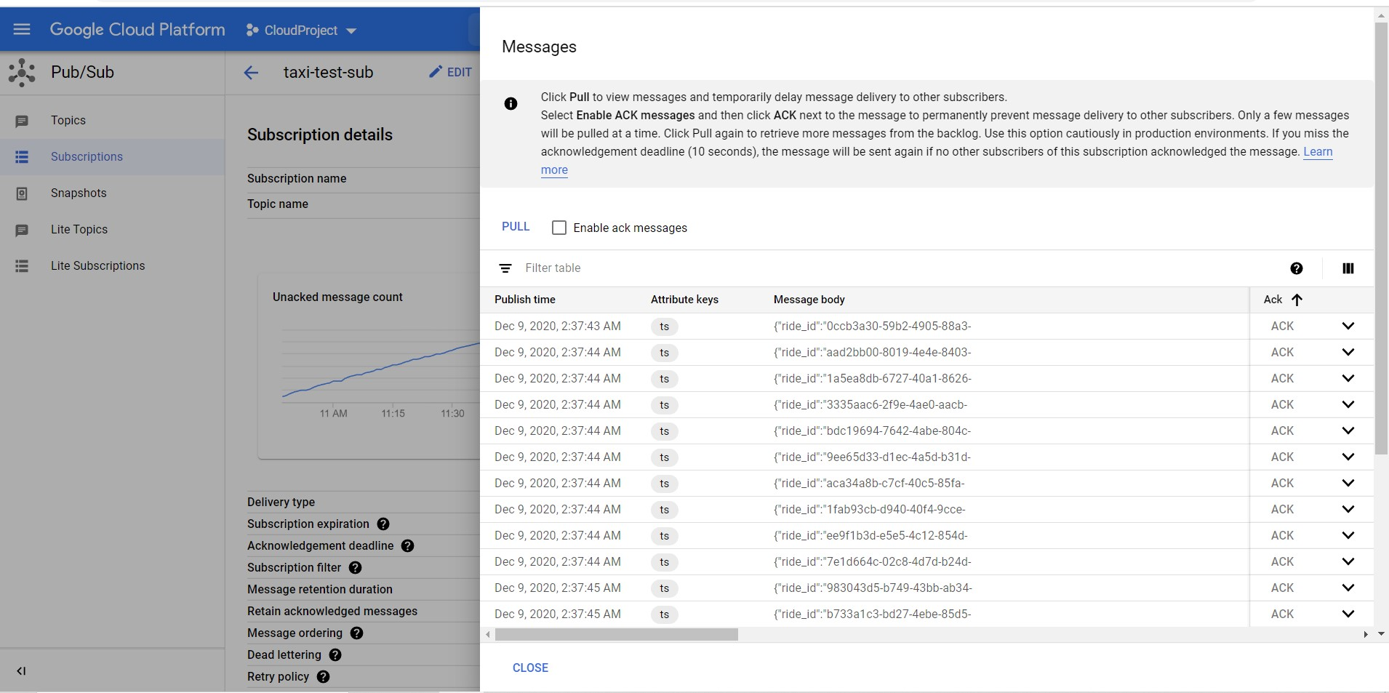
Pub/Sub (Create, View Message)

Slide 20

ML Models

Slide 21
Model Creation and Evaluation for the Total Distance - Linear Regression
CREATE OR REPLACE MODEL `taxirides.totalamount`
OPTIONS
(model_type='linear_reg', input_label_cols=['trip_distance']) AS
SELECT trip_distance,total_amount,passenger_count,
pickup_longitude, pickup_latitude
FROM
`bigquery-public-data.new_york_taxi_trips.tlc_yellow_trips_2015`
where trip_distance is not null
limit 1000;

Slide 22
Model Prediction for the Total Distance -
Linear Regression
SELECT * FROM ml.predict (model `taxirides.totalamount`,
(SELECT trip_distance,
total_amount,
passenger_count,
pickup_longitude, pickup_latitude
FROM `cloudproject-296118.taxirides.realtime_touse`
WHERE trip_distance IS NOT NULL ))

Slide 23
Model Creation and Evaluation for the Payment Type - Boosted Tree Classifier
CREATE OR REPLACE MODEL `taxirides.paytype`
OPTIONS
(model_type='BOOSTED_TREE_CLASSIFIER', input_label_cols=['P_type']) AS
SELECT payment_type as P_type,pickup_longitude as pick_long ,pickup_latitude as pick_la, passenger_count as passenger,trip_distance as distance,fare_amount as total_fare, total_amount as total,tip_amount as tips,extra as extra
FROM
`bigquery-public-data.new_york_taxi_trips.tlc_yellow_trips_2015`
limit 1500

Slide 24
Model Prediction for the Payment Type -
Boosted Tree Classifier
SELECT * FROM ML.predict (MODEL `taxirides.paytype`,
(SELECT
payment_type as P_type, pickup_longitude as pick_long ,pickup_latitude as pick_la, passenger_count as passenger, trip_distance as distance, fare_amount as total_fare, total_amount as total,tip_amount as tips, extra as extra
FROM
`bigquery-public-data.new_york_taxi_trips.tlc_yellow_trips_2016`
LIMIT 1000))

Slide 25
Model Creation and Evaluation for the Passenger Count - Boosted Tree Classifier
CREATE OR REPLACE MODEL`taxirides.count`
OPTIONS (model_type='BOOSTED_TREE_CLASSIFIER', input_label_cols=['passenger_count']) AS
SELECT cast(passenger_count as int64) as passenger_count, pickup_longitude,pickup_latitude,
FROM `bigquery-public-data.new_york_taxi_trips.tlc_yellow_trips_2015`
limit 1000

Slide 26
Model Prediction and Evaluation for the Passenger Count - Boosted Tree Classifier
SELECT * FROM ML.predict
(MODEL `taxirides.count`,
(SELECT
cast(passenger_count as int64) as passenger_count,
Pickup_longitude, pickup_latitude,
trip_distance as distance, total_amount as total,
FROM
`cloudproject-296118.taxirides.realtime_touse`
LIMIT 100))

Slide 27
Model Creation and Evaluation for Total Amount -
Linear Regression
CREATE OR REPLACE MODEL `taxirides.2015_TotalAmount`
OPTIONS
(model_type='linear_reg', input_label_cols=['total_amount']) AS
SELECT
total_amount as total_amount,
pickup_longitude as longitude,
pickup_latitude as latitude,
passenger_count as passenger
FROM
`bigquery-public-data.new_york_taxi_trips.tlc_yellow_trips_2015`
WHERE
total_amount IS NOT NULL

Slide 28
Model Evaluate and Predict for Total Amount -
Linear Regression
SELECT * FROM ML.EVALUATE(MODEL `taxirides.2015_TotalAmount`,
(
SELECT
total_amount as total_amount,
pickup_longitude as longitude,
pickup_latitude as latitude,
passenger_count as passenger
FROM
`cloudproject-296118.taxirides.realtime_touse`
WHERE
total_amount IS NOT NULL ))

Slide 29
Data Studio and YouTube Links
https://datastudio.google.com/u/0/reporting/f50352cc-124f-45e7-a2c0-8e794938de72/page/kTosB
https://www.youtube.com/watch?v=vfcM6OKfn_A

